Slide 1
Arabic Natural Language Processing:
Application for Gerunds in Arabic Language
Final Year Project Presentation
By:
Abderrahmane Aarab
Supervisor:
Prof. Mohammed Mourchid

Slide 2
TABLE OF CONTENTS
Introduction
The Arabic Language
01
02
NooJ &
Linguistic Resources
Java Application
03
04
General introduction & the project’s objectives
Linguistic overview of the Arabic language
Linguistic resources & the uses of Nooj
Showcase of the java application

Slide 3
01
Introduction
A general introduction to the project’s motivation & objectives

Slide 4
—Ludwig Wittgenstein
“The limits of my language mean the limits of my world.”

Slide 5
Arabic Language
Arabic is widely taught in schools and universities around the world and is used to varying degrees in workplaces, governments and the media. Arabic, in its Modern Standard Arabic form, is an official language of 26 states, the third most after English and French.

Slide 6
Arabic Natural Language Processing
NLP is a subfield of linguistics, computer science, and artificial intelligence concerned with the interactions between computers and human language. Arabic NLP helps to present the characteristics of this language and to classify the works handling it.

Slide 7
Problems of The Arabic Language
Among the most noticeable obstacles faced by students when learning Arabic are Gerunds “المصادر” . The Gerunds are one the most complicated derivational forms. It is based on several criteria (i.e. the type, the scheme of verb, and semantic aspect), that makes it difficult to find the hierarchy type representing the proposed patterns.

Slide 8
Project’s Motivation
In this project, we are interested in making an application that can:
Transform an Arabic verb phrase to a noun phrase.
Generate the gerund of a given verb.
Get the original verb from a given gerund.

Slide 9
PROJECT OBJECTIVES
Linguistic Resources
Analyse Arabic Text
Java Application
Create our linguistic resources to use with Nooj
Use Noojapply to analyze Arabic test
Make an app that displays Noojapply’s results

Slide 10
OVERVIEW OF THE APP’s FEATURES
XML Results
Seach & Filter
Read and Format the results as XML file.
Search & filter the diplayed results.
Java App
Analyse Text
Conversion
Analyse input text or a file for verbs and gerunds.
Offer the 3 types of conversion.

Slide 11
PROJECT TASKS & WORKLOAD
Database
Language Resources
Noojapply
Java Application

Slide 12
METHODOLOGY
Linguistic Study
01
02
Language Resources
Linguistic study on Arabic verbs and gerunds.
Update our language resources. (NooJ)
Java Application
04
03
Noojapply
Read, format, and display the results.
Use Noojapply to test the new resources.

Slide 13
02
The Arabic Language
A quick languistic study on the Arabic verbs and gerunds.

Slide 14
Arabic Verbs
Arabic verbs are based on a set of two to five (but usually three) consonants called a root.
The root communicates the basic meaning of the verb.
Changes to the vowels in between the consonants, along with prefixes or suffixes, specify grammatical functions such as person, gender, number, tense, mood, and voice.

Slide 15
Arabic Gerunds
Arabic use the root ف-ع-ل f-aa-l to indicate the particular shape of any given element of a verbal paradigm, also called the pattern.
It expresses the principal idea of an action or an action that has no reference time.
Each type of gerund has specific criteria representing the base for its construction.

Slide 16
This Project Focuses on The Following Gerunds:

Slide 17
The subjunctive case with " ان " in Arabic
The subjunctive as a concept in grammar refers to that which is uncertain or related to emotion.
Used after the word ”أن” with verbs of desire, emotion, or intention.
All five present tense conjugations, which end in a (dhamma) end instead with a (fatha) in the subjunctive.

Slide 18
Subjunctive Conjugations For The Verb يَدْرُسُ, دَرَس
Plural |  | Dual |  | Singular
نَدْرُسَ | نَحْنَ | تَدْرُسَا | أنتُما | أَدْرُسَ | أنا
تَدْرُسُوا | أنتُم | يَدْرُسَا | هما (m) | تَدْرُسَ | أنتَ
تَدْرُسْنَ | أنتُنَّ | تَدْرُسَا | هما (f) | تَدْرُسِي | أنتِ
يَدْرُسُوا | هم |  |  | يَدْرُسَ | هو
يَدْرُسْنَ | هنَّ |  |  | تَدْرُسَ | هي

Slide 19
03
NooJ & Language Resources
The creation of the language resources for Nooj.

Slide 20
Building Language Resources for NooJ
The most important thing during building any language recourse is to ensure that it reflects the structure of this language. For this reason, all the Arabic resources were built using root and pattern approach.

Slide 21
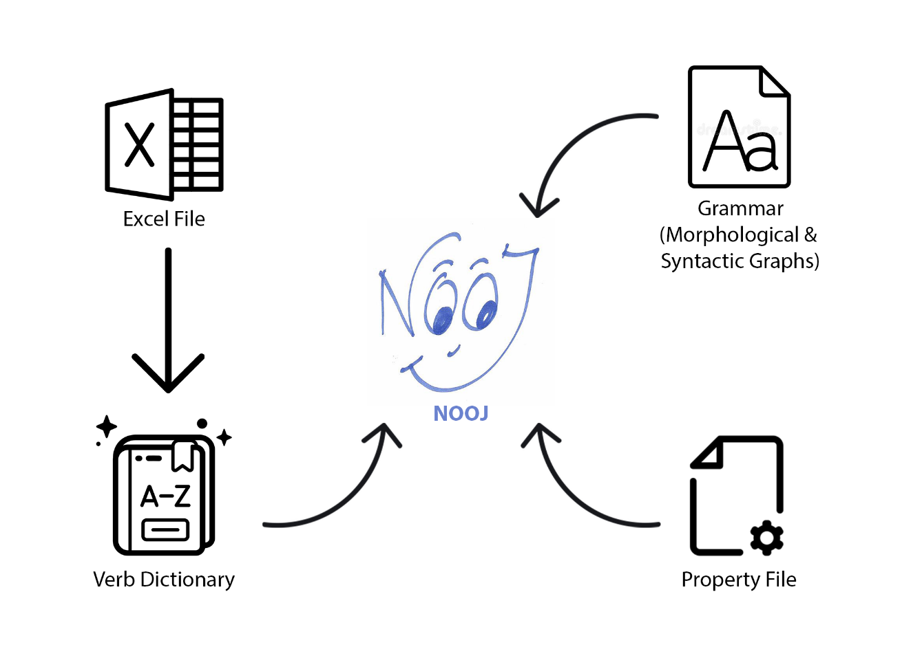
The components and resources required for NooJ:

Slide 22
LANGUAGE RESOURCES
Collection of Arabic Verbs that start with the letter “(R/ر)”, the corresponding gerunds, and other syntactic features.
Database
A constructed dictionary that contains the language vocabulary with their special linguistic features and uses our inflectional and derivational grammars
NooJ Dictionary
NooJ grammars that store all sets of inflectional & derivational rules. They are a structured sets of graphs that describe morphological paradigms.
NooJ Grammars

Slide 23
*Database “Excel File” Live-Preview*

Slide 24
*Dictionary “Bigdic.nod” Live-Preview*

Slide 25
*Inflectional Grammar “V_grammar.nof”
Live-Preview*

Slide 26
*Derivational Grammar “G_grammar.nof”
Live-Preview*

Slide 27
*Syntactic Grammar “A_grammar.nof”
Live-Preview*

Slide 28
NOOJAPPLY
Uses the provided resource to analyze a given text and returns the annotations, which contains the linguistic details about the given text.
Returns the annotations as an XML structure. We considered this file as the main input in our Java application.
The XML element are tags we pre-defined in the syntactical grammar in order to use them in our Java application.

Slide 29
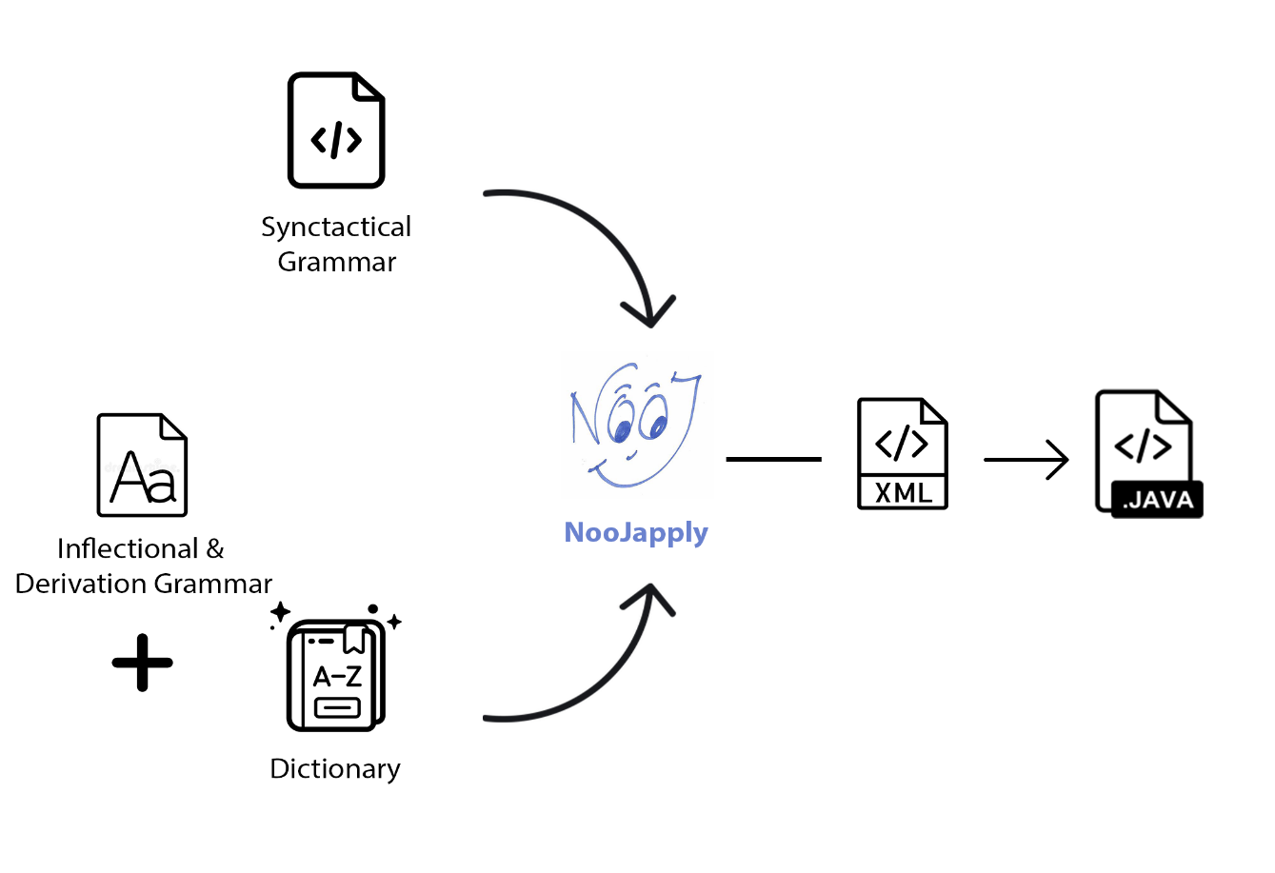
The Process of Noojapply:

Slide 30
04
Java Application
Showcase of the Java Application

Slide 31
Main Features of The Application
File Scan.
Text Scan.
Gerunds & verbs extraction from text.
Arabic verb phrase to noun phrase conversion.
Display of linguistics information of a given verb.

Slide 32
*File Scan Process Live-Preview*

Slide 33
* Text Scan Process Live-Preview*

Slide 34
*Verb - Gerund Conversion
Live-Preview*

Slide 35
*Verb Phrase to Noun Phrase Conversion
Live-Preview*

Slide 36
CONCLUSIONS
This project helps to give a better understanding of the Arabic language and to make it more accessible for others.
This project has given me a great first experience in the field of NLP and a whole new point of view on the difference and difficult aspects of the Arabic language that learners and researchers face when trying to deeply understand the language

Slide 37
THANK YOU FOR YOUR TIME

